Slide 1


WAVECOn Telecom Analysis

Slide 2
About WavecoN telecom
Wavecon, a leading telecommunications company in India, is known for providing dependable and innovative services.
In 2022, Wavecon reached a major milestone by launching its advanced 5G services, designed to give customers fast and consistent connections. This upgrade helps both individuals and businesses by encouraging creativity and new ideas. Wavecon has a significant presence in 15 major Indian cities and works hard to ensure its users have continuous connectivity.
The launch of 5G represents a new era of technological advancement for Wavecon.

Slide 3
Agenda
After the launch of 5G services , they seen in the decline in the revenue and active users , so they wanted to know about the following questions .
What is the impact of the 5G launch on our revenue?
Is there any plan affected largely by the 5G launch? Should we continue or discontinue that plan?
Is there any plan that is discontinued after the 5G launch? What is the reason for it?
Which KPI is underperforming after the 5G launch?
After the 5G launch, which plans are performing well in terms of revenue? Which plans are not performing well?
1.
2.
3.
4.
5.

Slide 4
Important KPI’s
ARPU
Average Revenue Per User
TAU
Total Active Users
TUsU
Total unsubscribed Users,
MA
Monthly Average

Slide 5
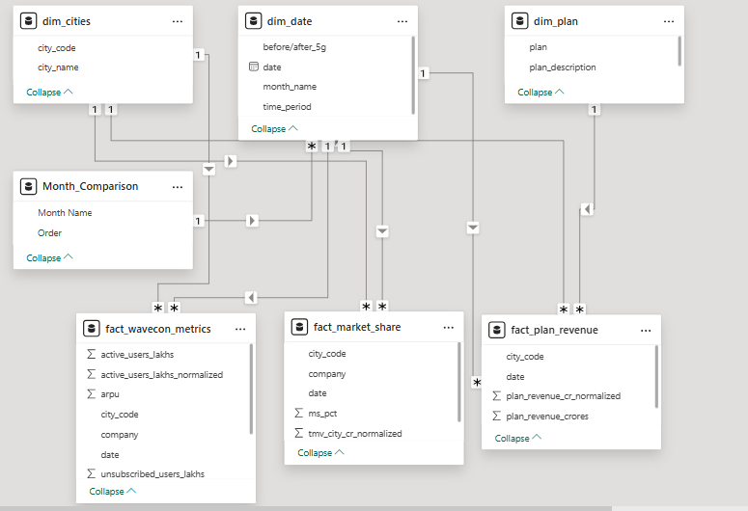
Lets first understand the database

Slide 6
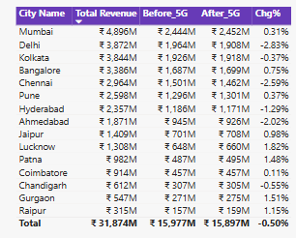
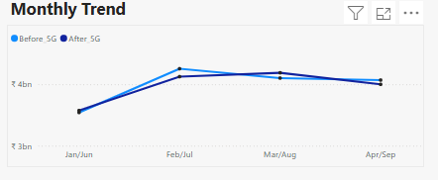
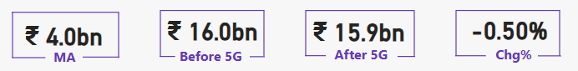

What is the impact of the 5G launch on our revenue?
After the launch of 5G revenue declined by 0.5% .
Main Reasons :
people are using old smartphone which is not 5G capable.
As 5G is newly launched it take times to adopt to 5G.

Slide 7
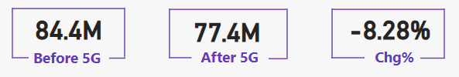
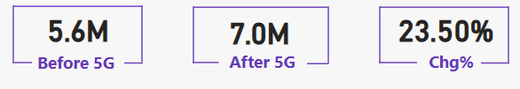

Which KPI is underperforming after the 5G launch?
Total active users
Total active users are declined by 8.28% after the launch of 5G
Total Unsubscribed users
Total unsubscribed users are increased by 23.5% after the launch of 5G

Slide 8
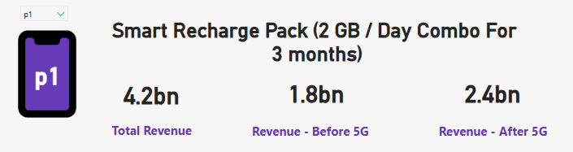
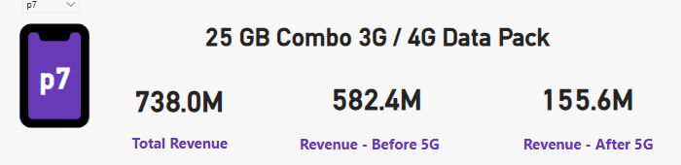

After the 5G launch,
which plans are performing well in terms of revenue
The revenue for ‘P1’ plan which is the ‘Smart recharge pack(2GB/Day combo for 3 months)” is increased after 5G launch , which resulted the revenue increase from 1.8BN to 2.4BN with 33.3% increased in revenue.
Which plans are not performing well
The revenue for ‘P7’ plan which is the ‘25 GB Combo 3G/4G data pack” is declined after 5G launch , which resulted the revenue drop of from 582M to 155M with 73.37% decreased in revenue

Slide 9
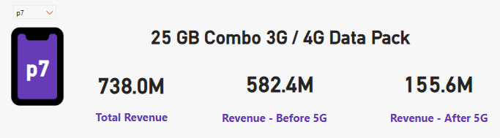

Is there any plan affected largely by the 5G launch? Should we continue or discontinue that plan?
After the launch of 5G 25GB combo 3G /4G data pack is highly effected and it resulted in revenue drop of 426.8M .
This is Outdated plan as everyone is trying to upgrade to 5G , 3G is outdated,

Slide 10
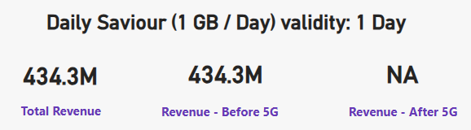
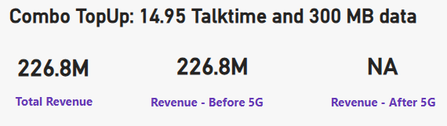
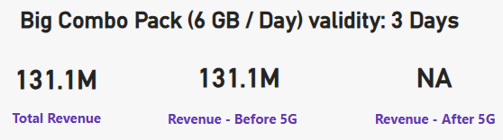
Is there any plan that is discontinued after the 5G launch? What is the reason for it?
3 plans got discontinued after the launch of 5G
These plans are low profitability and peoples are opting other plans which is value for money

Slide 11

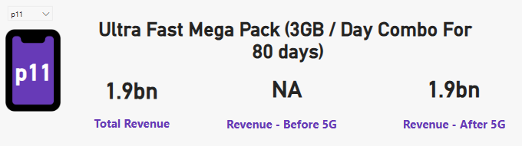
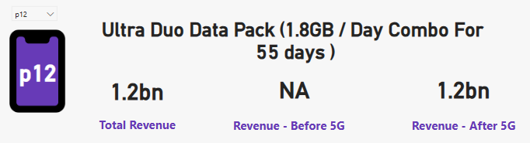
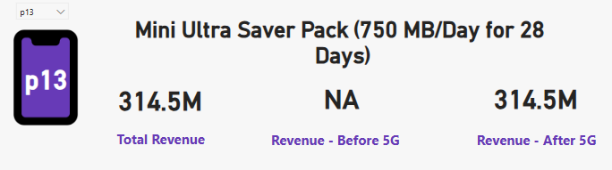

New plan introduced
The newly launched plans are performing well in terms of revenue, with an expected 25% growth in the coming years.
Plans P11 and P12 have surpassed $1 billion in revenue within just four months of the 5G launch.

Slide 12

THANK YOU.!!

